Slide 1
Q&A 3
Normalization
by:
ITI Staff

Slide 2
Relation → table
Insert
Update
Delete
Null
DB Design
ERD & Mapping
Analysis (Case study)
Tables + relationships
Top-down design
Sometimes (rules of normalization)
Normalization
Datasheets
Tables + relationships
Bottom-up design

Slide 3
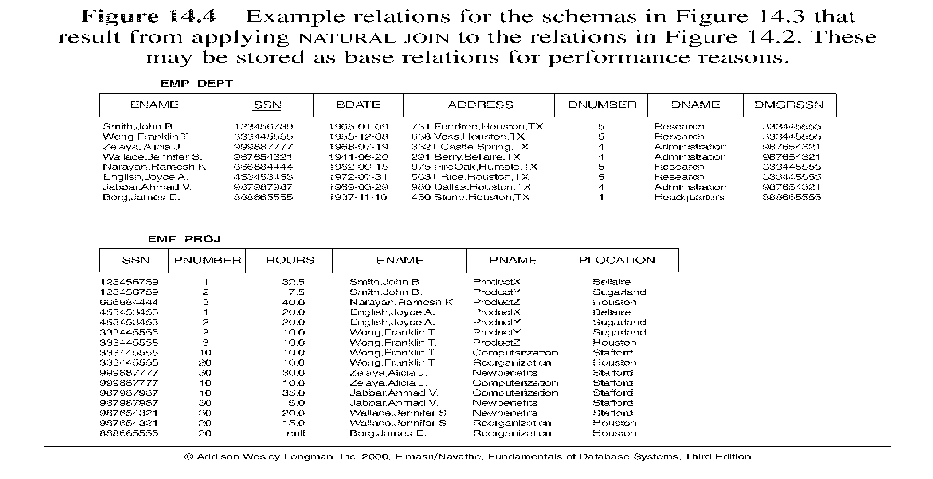
Normalization
Why do we use Normalization?
2 NF
Employee (SSN, Ename)
Project (Pnumber, Pname, Plocation)
Emp_Proj (SSN, Pnumber, hours)
Notes:
ERD is Top down
Normalization is bottom up
normalization plays only a limited role in database schema design if a top-down modeling approach like the entity- relationship approach is used.
Normalization however plays a major role when the bottom-up approach is being used. Normalization is then essential to build appropriate relations to hold the information of the enterprise.

Slide 4
Normalization Avoids
Duplication of Data
Insert Anomaly
Delete Anomaly
Update Anomaly
Frequent Null Values
Notes:
Duplication of Data – The same data is listed in multiple lines of the database
Insert Anomaly – A record about an entity cannot be inserted into the table without first inserting information about another entity – Cannot enter a customer without a sales order
Delete Anomaly – A record cannot be deleted without deleting a record about a related entity. Cannot delete a sales order without deleting all of the customer’s information.
Update Anomaly – Cannot update information without changing information in many places. To update customer information, it must be updated for each sales order the customer has placed
Using few Null values as possible: Attributes that are NULL frequently could be placed in separate relations (with the primary key)

Slide 5
Functional dependency
a constraint between two attributes (columns) or two sets of columns
A → B if “for every valid instance of A, that value of A uniquely determines the value of B” (A determine B)
or …A →B if “there exists at most one value of B for every value of A” (B is Functionally dependent on A)
Notes:
Functional dependencies (FDs) are used to specify formal measures of the "goodness" of relational designs
FDs and keys are used to define normal forms for relations
FDs are constraints that are derived from the meaning and interrelationships of the data attributes
A set of attributes A functionally determines a set of attributes B if the value of A determines a unique value for B

Slide 6
… functional dependency
some examples
social security number determines employee name
SSN -> ENAME
project number determines project name and location
PNUMBER -> {PNAME, PLOCATION}
employee ssn and project number determines the hours per week that the employee works on the project
{SSN, PNUMBER} -> HOURS
So functional dependency is the technical term for determines

Slide 7
keys and dependencies
EMPLOYEE1 (Emp_ID, Name, Dept_Name, Salary)
determinant
Emp_ID | Name | Dept_Name | Salary
functional dependency

Slide 8
EMPLOYEE2 (Emp_ID, Course_Title, Name, Address, Salary, Date_Completed)
Emp_ID | Course_ Title | Name | Address | Salary | Date_Comp.
not fully functionally dependant on the primary key

Slide 9
Definition
Normalization: The process of decomposing unsatisfactory "bad" relations by breaking up their attributes into smaller relations
Normal form: Condition using keys and FDs of a relation to certify whether a relation schema is in a particular normal form
Notes:
Normalization is carried out in practice so that the resulting designs are of high quality and meet the desirable properties
The practical utility of these normal forms becomes questionable when the constraints on which they are based are hard to understand or to detect
The database designers need not normalize to the highest possible normal form. (usually up to 3NF, BCNF or 4NF)
Denormalization: the process of storing the join of higher normal form relations as a base relation—which is in a lower normal form

Slide 10
0 NF → multivalued attribute, repeating groups, composite attribute
--------------
Relation
1 NF
2 NF
3 NF
-----------------
BCNF
4 NF
5 NF
Dnum | Dname | D_Phone | SSN | Ename | Address
10 | IT | 1234 | 100 | Aly | Alex
10 | IT | 1234 | 200 | Mohamed | Cairo
20 | Sales | 2545, 3654 | 300 | Mahmoud | Giza
20 | Sales | 2545, 3654 | 400 | Ahmed | Alex
10 | IT | 1234 | 500 | Mona | Alex
Dnum | Dname | D_Phone | SSN | Ename | Address
10 | IT | 1234 | 100, 200,500 | Aly, Mohamed, Mona | Alex, Cairo, Alex
20 | Sales | 2545, 3654 | 300, 400 | Mahmoud, Ahmed | Giza, Alex
multivalue
Repeating groups

Slide 11
0 NF → multivalued attribute, repeating groups, composite attribute
--------------
Relation
1 NF
2 NF
3 NF
-----------------
BCNF
4 NF
5 NF
Dnum | Dname | D_Phone | SSN | Ename | Address
10 | IT | 1234 | 100, 200,500 | Aly, Mohamed, Mona | Alex, Cairo, Alex
20 | Sales | 2545, 3654 | 300, 400 | Mahmoud, Ahmed | Giza, Alex
multivalue
Repeating groups
1 NF
Department (Dnum, Dname)
Department_Telephone (Dnum, D_Phone)
Employee (SSN, Ename, Address, Dno)

Slide 12
1NF
relation is in first normal form if it contains no multivalued or composite attributes
remove repeating groups to a new table as already demonstrated, “carrying” the PK as a FK
All columns (fields) must be atomic
  Means : no repeating items in columns
Notes:
Disallows composite attributes, multivalued attributes, and nested relations; attributes whose values for an individual tuple are non-atomic
Considered to be part of the definition of relation

Slide 13
2NF
a relation is in second normal form if it is in first normal form AND every nonkey attribute is fully functionally dependant on the primary key
i.e. remove partial functional dependencies, so no nonkey attribute depends on just part of the key

Slide 14
EMPLOYEE2 (Emp_ID, Course_Title, Name, Address, Salary, Date_Completed)
Emp_ID | Course_ Title | Name | Address | Salary | Date_Comp.
not fully functionally dependant on the primary key

Slide 15
2NF
a relation is in 2NF if it is in 1NF and any one of these is true:
  the PK consists of only 1 attribute
  all attributes are part of the PK (no nonkey attributes)
  every non key attribute is functionally dependant on the whole PK

Slide 16
1NF →2NF
EMPLOYEE2 (Emp_ID, Course_Title, Name, Address, Salary, Date_Completed) ➔
EMPLOYEE1 (Emp_ID, Name, adress, Salary)
and
EMP_COURSE (Emp_ID, Course_Title, Date_Completed)
EMPLOYEE1 satisfies condition1
EMP_COURSE satisfies condition3

Slide 17
3NF
a relation is in third normal form if it is in 2NF, AND no transitive dependencies exist
transitive dependency is a functional dependency between nonkey attributes

Slide 18
transitive dependency
transitive
dependency
Cust_ID | Name | City | Region

Slide 19
Cust_ID | Name | city | Region
City | Region
Cust_ID | Name | City

Slide 20
ITI Example
ITI Students Sheet
Track Name : PD Track Description: Professional Development
Graduate Profile: ALL
Appno | Name | F-code | Faculty | Major | Address | Telno | Found. Grade | Total Att. Hrs | Start date
123 | Ahmed | SC-phy | Science | Physics | Haram | 33868420 | A | 600 | 14 Sep
124 | Mona | Eng-cs | Engineering | Computer | Dokki | 33897455,33897445 | B | 591 | 15 Sep
127 | Ali | Com-ac | Commerce | Accounting | Nasr City | 22415939 | A | 550 | 21 Sep
223 | Karim | Med-bio | Medicine | Biochemistry | Sheraton | 22868456 | C | 600 | 14 Sep
Notes:
1NF :
Platform :pfname , pfdesc , pfgraduate
Students: pfname, appno, name , f-code ,faculty , major , address, Foundgrade, attd , start_date
Std_Tel: appno, telno
2NF:
Students: appno, name , f-code , faculty , major , address
Students_pf: pfname,appno, Foundgrade, attd , start_date
Unchanged Tables
Platform :pfname , pfdesc , pfgraduate
Std_Tel: appno, telno
3NF
Students: appno, name , f-code, address
Fac_majors:f-code , faculty name , major
Unchanged Tables
Platform :pfname , pfdesc , pfgraduate
Std_Tel: appno, telno
Students_pf: pfname,appno, Foundgrade, attd , start_date

Slide 21
0NF(Track_name, desc, Profile, Appno, Name, F-code, Faculty, Major, Address, Tel, Grade, Att, st_Date)
Tname | Desc | Prof | Appno | Name | Fcode | Faculty | Maj | Address | Tel | Grade | Att | St_Date
PD | Prof. Dev. | All | 123 | Ahmed | SC-phy | Science | Physics | Haram | 33868420 | A | 600 | 14 Sep
 |  |  | 124 | Mona | Eng-cs | Engineering | Computer | Dokki | 33897455,33897445 | B | 591 | 15 Sep
 |  |  | 127 | Ali | Com-ac | Commerce | Accounting | Nasr City | 22415939 | A | 550 | 21 Sep
 |  |  | 223 | Karim | Med-bio | Medicine | Biochemistry | Sheraton | 22868456 | C | 600 | 14 Sep
1NF
Track (Track_name, desc, Profile)
Student_track (track_name, Appno, Name, F-code, Faculty, Major, Address, Grade, Att, st_Date)
Student_tel (Appno, phone)
2NF
Track, student_tel → unchanged
Student (Appno, Name, F-code, Faculty, Major, Address)
Student_track_2 (track_name, Appno, Grade, Att, st_Date)
3 NF
Track, student_tel, Student_track_2 → unchanged
Faculty (F-code, Faculty, Major)
Student_3 (Appno, Name, F-code, Address)

Slide 22
1st Normal Form
Normalization: First Normal Form
Separate Repeating Groups into New Tables.
Repeating Groups Fields that may be repeated several times for one document/entity
Create a new table containing the repeating data
The primary key of the table (repeating group) is always a composite key; Usually document number and a field uniquely describing the repeating line, like an item number.

Slide 23
1NF :
Platform :pfname , pfdesc , pfgraduate
Students: pfname, appno, name , faculty , major , address, Foundgrade, attd , start_date
Std_Tel: appno, telno

Slide 24
2NF
Students: appno, name , faculty , major , address
Students_pf: pfname,appno, Foundgrade, attd , start_date
Unchanged Tables
Platform :pfname , pfdesc , pfgraduate
Std_Tel: appno, telno

Slide 25
3NF
Students: appno, name , major, address
Fac_majors:faculty , major
Unchanged Tables
Platform :pfname , pfdesc , pfgraduate
Std_Tel: appno, telno
Students_pf: pfname,appno, Foundgrade, attd , start_date

Slide 26
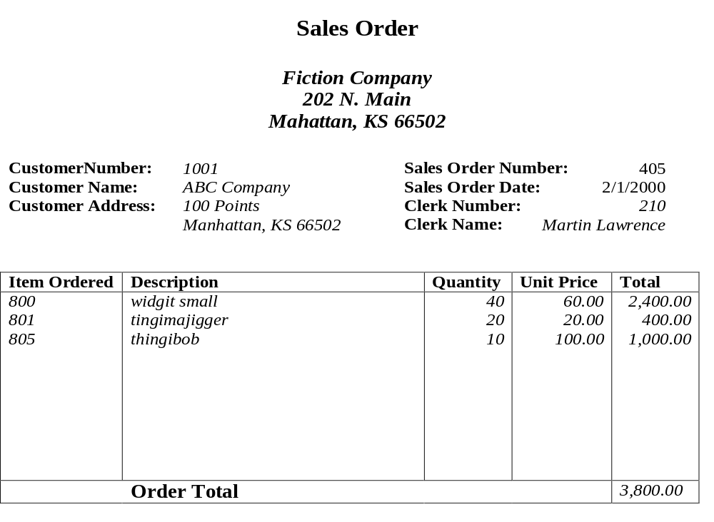
0NF(CustNo, CustName, CustAdd, SON, SOD, ClecrkNo, ClerkName, Item, Desc, Qtty, Price)
1NF
Sales (CustNo, CustName, CustAdd, SON, SOD, ClecrkNo, ClerkName)
Sales_Item (SON, Item, Desc, Qtty, Price)
2NF
Sales → unchanged
Item (Item, Desc, price)
Sales_Item_2 (SON, Item, Qtty)
3NF
Item, Sales → unchanged
Customer (CustNo, CustName, CustAdd)
Clerk (ClerkNo, ClerkName)
Sales_3(SON, SOD, CustNo, ClerkNo)

Slide 27
0NF (custNo, CustName,CustAdd,SON,SOD,ClerkNo,ClerkName, ItemNo,
Desc, Quantity, unitPrice)
1NF
Sales_order (custNo, CustName,CustAdd,SON,SOD,ClerkNo,ClerkName)
Sales_Items (SON, ItemNo, Desc, Quantity, UnitPrice)
2NF
Sales_order (custNo, CustName,CustAdd,SON,SOD,ClerkNo,ClerkName)
Items (ItemNo, Desc, UnitPrice)
Sales_Items_1 (SON, ItemNo, Quantity)
3NF
Customer (CustNo, CustName, CustAdd)
Clerk (ClerkNo, ClerkName)
Sales_order (custNo,SON,SOD,ClerkNo)
Items (ItemNo, Desc, UnitPrice)
Sales_Items_1 (SON, ItemNo, Quantity)

Slide 28
Solution
SalesOrderNo, Date, CustomerNo, CustomerName, CustomerAdd, ClerkNo, ClerkName, ItemNo, Description, Qty, UnitPrice
First Normal Form
The new table is as follows:
SalesOrderNo, ItemNo, Description, Qty, UnitPrice
The repeating fields will be removed from the original data table, leaving the following.
SalesOrderNo, Date, CustomerNo, CustomerName, CustomerAdd, ClerkNo, ClerkName

Slide 29
2nd Normal Form
The new table will contain the following fields:
ItemNo, Description, UnitPrice
SalesOrderNo, ItemNo, Qty
SalesOrderNo, Date, CustomerNo, CustomerName, CustomerAdd, ClerkNo, ClerkName
Notes:
The new table will contain the following fields:
ItemNo, Description
All of these fields except the primary key will be removed from the original table. The primary key will be left in the original table to allow linking of data:
SalesOrderNo, ItemNo, Qty, UnitPrice
Price may be treated as dependent on item. Also, Price may be different for different sales orders (discounts, special customers, etc.) which means price may be dependent on Sales Order Number and Item Number.
Along with the unchanged table below, these tables make up a database in second normal form:
SalesOrderNo, Date, CustomerNo, CustomerName, CustomerAdd, ClerkNo, ClerkName

Slide 30
3rd Normal Form
CustomerNo, CustomerName, CustomerAdd
ClerkNo, ClerkName
SalesOrderNo, Date, CustomerNo, ClerkNo
Unchanged Tables
ItemNo, Description
SalesOrderNo, ItemNo, Qty, UnitPrice
Notes:
CustomerNo, CustomerName, CustomerAdd
ClerkNo, ClerkName
All of these fields except the primary key will be removed from the original table. The primary key will be left in the original table to allow linking of data as follows:
SalesOrderNo, Date, CustomerNo, ClerkNo
Together with the unchanged tables below, these tables make up the database in third normal form.
ItemNo, Description
SalesOrderNo, ItemNo, Qty, UnitPrice

Slide 31
Completed Tables in 3rd Normal Form
Customers: CustomerNo, CustomerName, CustomerAdd
Clerks: ClerkNo, ClerkName
Inventory Items: ItemNo, Description, UnitPrice
Sales Orders: SalesOrderNo, Date, CustomerNo, ClerkNo
SalesOrderDetail: SalesOrderNo, ItemNo, Qty,

